Slide 1
Fasthttp client internals
Aliaksandr Valialkin, VertaMedia

Slide 2
What is fasthttp?
A package with fast implementations of http server and clients.
Faster than the net/http by up to 10x.
Located at http://github.com/valyala/fasthttp .

Slide 3
TechEmpower benchmarks
Benchmarks for various http server frameworks
Results are located at https://www.techempower.com/benchmarks/
Fasthttp server took part in round 12 and round 13

Slide 4
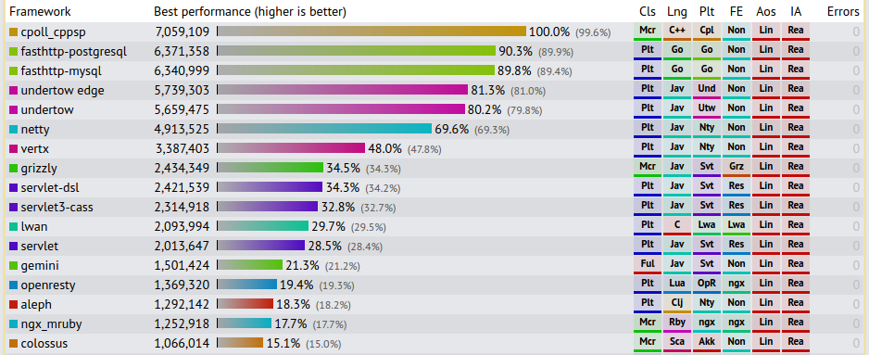
TechEmpower /plaintext results (round 12)

Slide 5
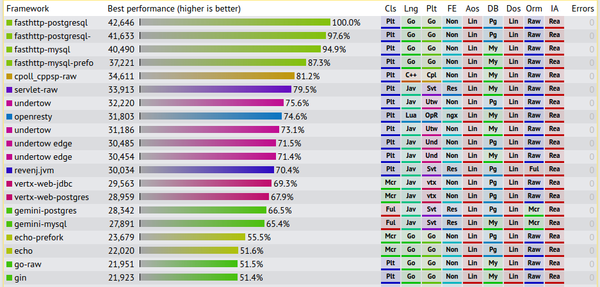
TechEmpower /fortunes results (round 13 preview)

Slide 6
Fasthttp server is great!
What about fasthttp client?

Slide 7
Fasthttp clients overview
Client
HostClient
PipelineClient

Slide 8
fasthttp.Client
General-purpose HTTP client
May limit open connections per host
May be used by web crawlers
Docs at https://godoc.org/github.com/valyala/fasthttp#Client

Slide 9
fasthttp.HostClient
Sends requests to a predefined servers list
May limit open connections
May be used by web proxies and API clients
Docs at https://godoc.org/github.com/valyala/fasthttp#HostClient

Slide 10
fasthttp.PipelineClient
Sends pipelined requests to the given server over a limited number of open connections
May be used by API clients
May suffer from Head of Line blocking
Docs at https://godoc.org/github.com/valyala/fasthttp#PipelineClient

Slide 11
fasthttp.HostClient internals

Slide 12
Let’s start with a naive HTTP client
func Get(url string) *Response { conn := dialHost(url) defer conn.Close() sendRequest(conn, url) return recvResponse(conn) }

Slide 13
Issue #1: connection is established per each request
Use per-host connection pools + http keep-alive:
func Get(url string) *Response { connPool := connPoolForHost(url) conn := connPool.Get() defer connPool.Put(conn) sendKeepAliveRequest(conn, url) return recvResponse(conn) }

Slide 14
Issue #2: response object is allocated per each request
Modify API, so the request object may be re-used:
func Get(url string, resp *Response) { connPool := getPoolForHost(url) conn := connPool.Get() defer connPool.Put(conn) sendKeepAliveRequest(conn, url) recvResponse(conn, resp) }

Slide 15
Now the caller may re-use response object
This reduces memory allocation overhead and improves performance:
func fetchURLS(ch <-chan string) { var r Response for url := range ch { Get(url, &r) processResponse(&r) // reset response object, so it may be re-used r.Reset() } }

Slide 16
Issue #3: ‘Connection: close’ handling
Do not put connection into pool if ‘Connection: close’ header is present either on request or response
Close such connection instead

Slide 17
‘Connection: close’ handling
func Get(url string, resp *Response) { connPool := getPoolForHost(url) conn := connPool.Get() sendKeepAliveRequest(conn, url) recvResponse(conn, resp) if resp.ConnectionClose() { // <- see here conn.Close() } else { connPool.Put(conn) } }

Slide 18
Issue #4: Slow servers, broken networks
Server may stop responding,
so goroutines calling Get() may
pile up indefinitely

Slide 19
Naive solution:
func GetTimeout(url string, timeout time.Duration,
resp *Response) { ch := make(chan struct{}) go func() { Get(url, resp) // goroutines still pile up here close(ch) }() select { case <-ch: case <-time.After(timeout): } }

Slide 20
Solution #1: limit the number of goroutines blocked in Get()
func GetTimeout(url string, timeout time.Duration, resp *Response) { select { case concurrencyCh <- struct{}{} default: // too many goroutines are blocked in Get() } ch := make(chan struct{}) go func() { Get(url, resp) <-concurrencyCh close(ch) } select { case <-ch: case <-time.After(timeout): } }

Slide 21
Solution #2: set timeouts on connection
This will unblock goroutines calling Get() on stuck servers / connections:
conn := dialHost(url) conn.SetReadDeadline(time.Now().Add(readTimeout)) conn.SetWriteDeadline(time.Now().Add(writeTimeout))

Slide 22
Solution #1 has a data race on response
func GetTimeout(url string, timeout time.Duration, resp *Response) { select { case concurrencyCh <- struct{}{} default: // too many goroutines are blocked in Get() } respCopy := acquireResponse() // <- prevent data race here ch := make(chan struct{}) go func() { Get(url, respCopy) <-concurrencyCh close(ch) } select { case <-ch: respCopy.CopyTo(resp) releaseResponse(respCopy) case <-time.After(timeout): // <- data race was here } }

Slide 23
Should the connection be closed on timed out request?
Yes, if you want DoS’ing slow server :)
Otherwise let it respond to timed out request.
See fasthttp.clientGetURLDeadline for details.

Slide 24
Now we have fast Client?
Not yet :(
Let’s dig into connection pool

Slide 25
Naive connection pool implementation
type connPool struct { // Addr is a host address the connection pool is for Addr string // connsLock protects conns from concurrent update connsLock sync.Lock // conns contains a pool of free open connections
// to the Addr conns []net.Conn }

Slide 26
Naive connPool.Get()
func (cp *connPool) Get() net.Conn { var c net.Conn cp.connsLock.Lock() n := len(cp.conns)-1 if n >= 0 { c = cp.conns[n] cp.conns = cp.conns[:n] } cp.connsLock.Unlock() if c == nil { c = dialHost(cp.Addr) } return c }

Slide 27
Naive connPool.Put()
func (cp *connPool) Put(c net.Conn) { cp.connsLock.Lock() cp.conns = append(cp.conns, c) cp.connsLock.Unlock() }

Slide 28
Issue #1: connPool size is unlimited
The following problems may appear when a lot of concurrent requests are sent to a slow server:
Client DoS - too many resources (socket descriptors, connection objects, goroutines, memory) used by the connPool
Server DoS - too many connections established to the server

Slide 29
Solution: limit connPool size
No code here, since it doesn’t fit
into a single slide :)
See fasthttp.HostClient.acquireConn() for details

Slide 30
Issue #2: unused open connections’ leak
connPool may accumulate a lot of unused open connections after requests’ spike
This may lead to:
Resource waste on the client
Resource waste on the server

Slide 31
Solution: limit unused connections’ lifetime
No code here.
See fasthttp.HostClient.connsCleaner for details.

Slide 32
Now we have fast and robust Client?
Not yet :(
Let’s dig into dialHost

Slide 33
Naive dialHost implementation
func dialHost(addr string) net.Conn { c, err := net.Dial("tcp", addr) // handle non-nil err here return c }

Slide 34
Issue #1: net.Dial may issue DNS requests per each call
High-frequency non-keepalive requests may lead to:
DNS subsystem overload
Excessive CPU usage due to superfluous DNS calls

Slide 35
Solution: cache ‘host -> ip’ mappings for a short period of time
See fasthttp.tcpDialer.getTCPAddrs for details

Slide 36
Issue #2: uneven load on servers behind a single domain name
Dial all the ips for the given domain name in a round-robin fashion
See fasthttp.tcpDialer.getTCPAddrs for details

Slide 37
Issue #3: net.Dial may hang for extended durations
This may lead to client resource leak:
Goroutines calling Get() will pile up on net.Dial
This leads to high memory usage for blocked goroutines’ stacks

Slide 38
Solution: add timeout to dialHost
See fasthttp.tryDial for details

Slide 39
Additional HostClient features
Spread load among multiple hosts listed in HostClient.Addr
Skip faulty hosts
TLS (aka SSL or HTTPS) support

Slide 40
fasthttp.Client internals

Slide 41
Client uses a HostClient per each distinct host
func Get(url string, resp *Response) { hc := hostClientForHost(url) hc.Get(url, resp) }

Slide 42
Client destroys unused HostClients, so they don’t occupy resources
See fasthttp.Client.mCleaner for details

Slide 43
fasthttp.PipelineClient internals

Slide 44
Each connection is served by two goroutines
pipelineConnClient.writer - writes pipelined requests to the connection
pipelineConnClient.reader - reads responses from the connection

Slide 45
PipelineClient.Get() implementation
type pipelineWork struct { url string resp *Response done chan struct{} } func (pc *PipelineClient) Get(url string, resp *Response) { w := &pipelineWork{ url: url, resp: resp, done: make(chan struct{}), } pc.chW <- w <-w.done }

Slide 46
Performance comparison

Slide 47
Fasthttp client benchmark results
FasthttpClientGetEndToEnd1Inmemory-4 300000 3860 ns/op 0 B/op 0 allocs/op
FasthttpClientGetEndToEnd10Inmemory-4 300000 3890 ns/op 1 B/op 0 allocs/op
FasthttpClientGetEndToEnd100Inmemory-4 300000 3899 ns/op 7 B/op 0 allocs/op
FasthttpClientGetEndToEnd1000Inmemory-4 300000 5401 ns/op 153 B/op 0 allocs/op

Slide 48
net/http client benchmark results
NetHTTPClientGetEndToEnd1Inmemory-4 50000 25453 ns/op 5396 B/op 67 allocs/op
NetHTTPClientGetEndToEnd10Inmemory-4 50000 28014 ns/op 5414 B/op 66 allocs/op
NetHTTPClientGetEndToEnd100Inmemory-4 50000 31063 ns/op 5569 B/op 66 allocs/op
NetHTTPClientGetEndToEnd1000Inmemory-4 20000 52500 ns/op 10841 B/op 92 allocs/op

Slide 49
Questions
Fasthttp source code: https://github.com/valyala/fasthttp
Author: Aliaksandr Valialkin, valyala@gmail.com, VertaMedia

